Slide 1





Development Tools
Building Rock-Solid Software the Easier Way
High-Quality Code
SoftUni Team
Technical Trainers
http://softuni.bg
Software University

Slide 2

Table of Contents
Integrated Development Environments (IDEs)
Source Control Systems
Code Generation Tools
Logging Tools
Bug Tracking / Issue Tracking Systems
Code Analysis Tools
Code Decompilation Tools
Documentation Tools

Slide 3
Table of Contents (2)
Code Obfuscators
Code Profilers
Refactoring Tools
Automated Build Tools
Documentation Generators
Project Hosting and Team Collaboration Sites

Slide 4
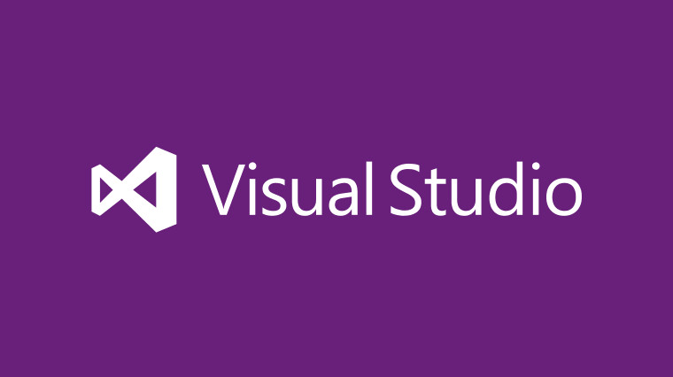
Integrated Development Environments (IDEs)
Visual Studio

Slide 5
Visual Studio
Visual Studio is official .NET development tool from Microsoft
Multiple languages: C#, VB.NET, C++, JavaScript, …
Multiple technologies and platforms: ASP.NET, WPF, Silverlight, WWF, WCF, Windows Phone
Very powerful and feature rich
Write, compile, model, design GUI, forms, data, build, execute, debug, test, deploy, refactor, …
Commercial product, has free editions
Visual Studio 2015 RTM (20 July 2015)

Slide 6
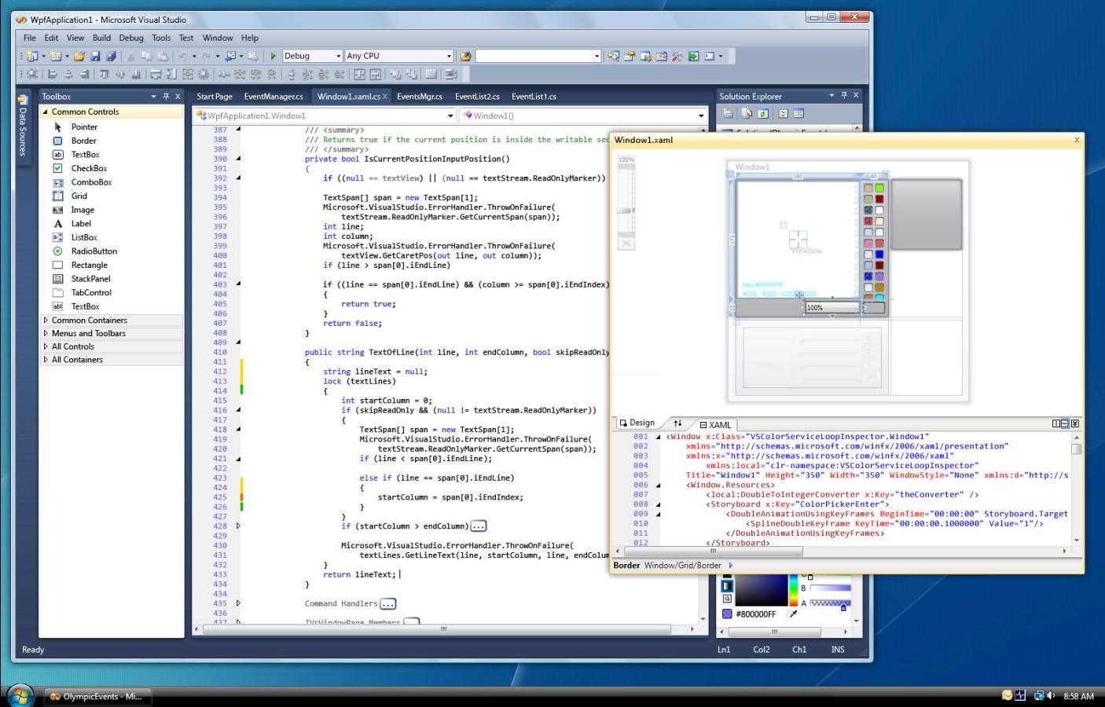
Visual Studio – Screenshot

Slide 7
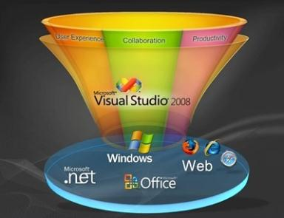
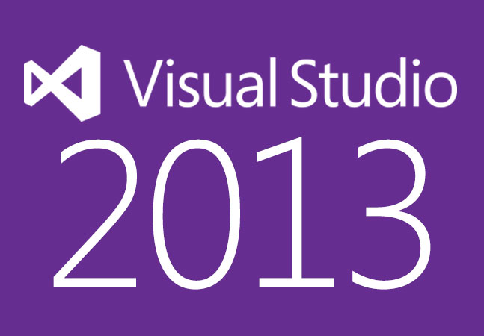

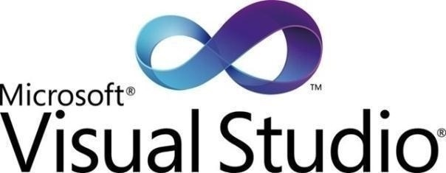
Visual Studio
Live Demo

Slide 8





Source Control Systems
Subversion (SVN), Team Foundation Server (TFS), CVS, Git, Mercurial, Perforce, …

Slide 9
What is Source Control System?
Source control systems (version control systems, source control repositories)
Hold the source code and project assets during the development process
Allow simultaneous changes in the source code and conflict resolution
Keep version history of the project assets
Two versioning models:
Lock-Modify-Unlock and Copy-Modify-Merge

Slide 10
Lock-Modify-Unlock Model
The lock-modify-unlock model needs locking files before modification
One file is modified by at most one person in any given moment
No conflicts, no need of merge
Suitable for small teams
When changes almost don't need concurrency
Basic commands: check out, check-in
Implemented in: Visual SourceSafe, (TFS, SVN)

Slide 11
Copy-Modify-Merge Model
Copy-modify-merge model does not hold locks during the source code modification
The same file could be simultaneously edited by multiple developers
Sometimes requires conflict resolution
Suitable for large teams and projects
High concurrency of source code modifications
Basic commands: update, commit
Implemented in: SVN, CVS, Git, Mercurial, TFS

Slide 12
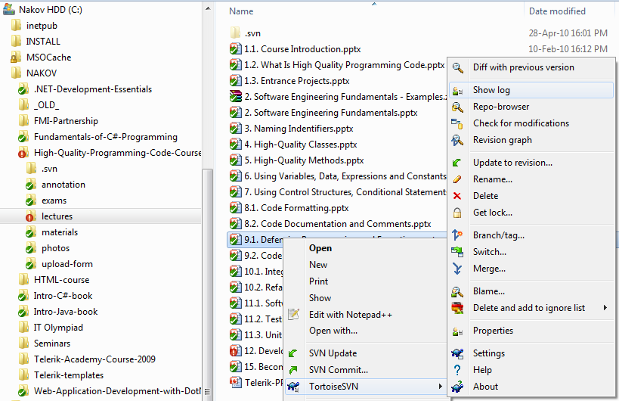
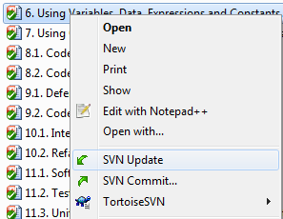
Subversion (SVN)
Subversion (SVN)
Popular and well established system
Free, open-source, very large community
TortoiseSVN – the most popular client

Slide 13
Subversion (SVN) (2)
Subversion (SVN)
Official web site:
http://subversion.tigris.org/
Runs on UNIX, Linux, Windows
Console client
svn
GUI client
TortoiseSVN – http://tortoisesvn.tigris.org/

Slide 14
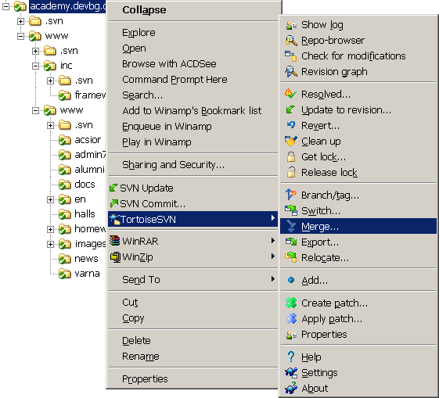
TortoiseSVN
TortoiseSVN
Open source GUI client for Subversion
Integrated in Windows Explorer
http://tortoisesvn.tigris.org/

Slide 15
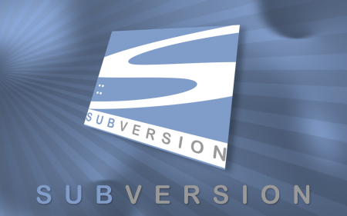
Subversion
Live Demo

Slide 16
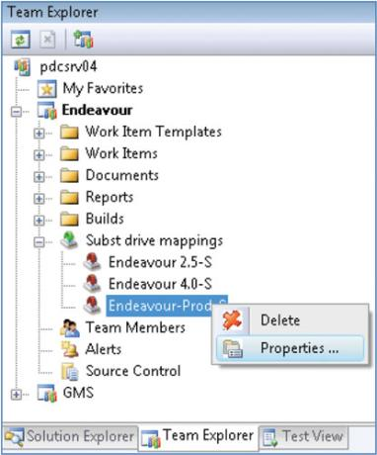
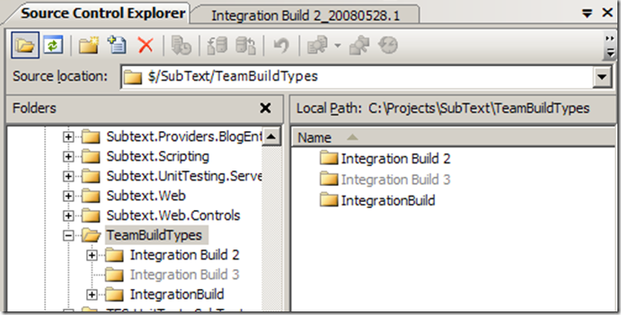
Team Foundation Server
Microsoft Team Foundation Server (TFS)
Works best with Visual Studio
Many problems outside of it
Commercial license

Slide 17
Other Source Control Systems
CVS
Was extremely popular in the past
Now it is obsolete
Open source, mostly used in UNIX / Linux
Git and Mercurial
Fast, distributed, open source
Perforce
Very powerful and scalable (pentabytes of code)
Commercial product (used by SAP)

Slide 18

Code Generation Tools
Visual Studio T4 Engine

Slide 19
Code Generators – Concepts
Source code generation
Template based
Build data access layer by given database schema
E.g. Visual Studio Data Designer for LINQ-to-SQL
Build Web application by database schema
E.g. Django (Python based Web application platform)
Model based
Build entire application by high-level model

Slide 20
Microsoft T4 Template Engine
Visual Studio T4 Engine
T4 == Text Template Transformation Toolkit
Integral part of Visual Studio
ASP.NET-like syntax
T4 templates consist of:
Processing directives (e.g. include template)
Text blocks (static text)
Code blocks (in C#, VB.NET)
Compiled to C# and then to .NET assemblies

Slide 21
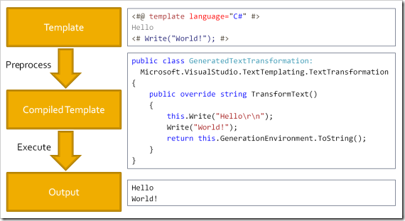
T4 Template Engine – Architecture

Slide 22
Visual Studio T4 Example
<#@ template debug="false" hostspecific="false" language="C#" #>
<#@ assembly name="System.Core" #>
<#@ import namespace="System.Text" #>
<#@ import namespace="System.Collections.Generic" #>
<#@ output extension=".cs" #>
<# for(int i = 0; i < 3; i++) { #>
public int Item<#=i#> { get; set; }
<# } #>
public int Item0 { get; set; }
public int Item1 { get; set; }
public int Item2 { get; set; }

Slide 23
Visual Studio T4 Example (2)
<#@ template language="C#" hostspecific="true" #>
<#@ output extension=".xml" #>
<#@ import namespace="System.IO" #>
<#@ import namespace="Microsoft.VisualStudio.TextTemplating" #>
<?xml version="1.0" ?>
<project>
<# string currentDir = this.Host.ResolvePath(".");
foreach (string dir in Directory.GetFiles(currentDir))
{
FileInfo fileInfo = new FileInfo(dir);
#>
<file><#= fileInfo.Name #></file>
<# } #>
</project>

Slide 24

Visual Studio T4 Template Engine
Live Demo

Slide 25





Logging Tools
Log4Net

Slide 26
Logging
Logging is chronological and systematic record of data processing events in a program
E.g. the Windows Event Log
Logs can be saved to a persistent medium to be studied at a later time
Use logging in the development phase:
Logging can help you debug the code
Use logging in the production environment:
Helps you troubleshoot problems

Slide 27
Log4Net
Log4Net popular logging frameworks for .NET
Reliable, fast and extensible
Simple to understand and to use API
Allows the developer to control which log statements are output with arbitrary granularity
Fully configurable at runtime using external configuration files

Slide 28
Log4Net Architecture
Log4Net has three main components:
Loggers
Channels for printing logging information
Appenders
Output destinations (e.g. XML file, database, …)
Layouts
Formats that appenders use to write their output

Slide 29
Hello Log4Net – Example
class Log4NetExample
{
private static readonly ILog log =
LogManager.GetLogger(typeof(Log4NetExample));
static void Main()
{
BasicConfigurator.Configure();
log.Debug("Debug message");
log.Error("Error message");
}
}
Output from Log4NetExample
2010-12-16 23:25:08 DEBUG Log4NetExample – Debug message
2010-12-16 23:25:08 ERROR Log4NetExample – Error message
…

Slide 30
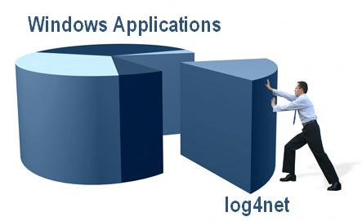
Log4Net
Live Demo

Slide 31


Bug Tracking / Issue Tracking Systems
TRAC, Bugzilla, JIRA, TFS, SourceForge, Google Code, CodePlex, GitHub

Slide 32
Bug Tracking Systems
Bug tracking / issue tracking systems
Track bugs / issues related to software development, called tickets
Tickets consist of:
Category: bug / feature request / task
State: new → assigned → fixed / implemented → closed
Priority: critical / high / medium/ low / etc.
Owner / responsible person
Summary, description, attachments

Slide 33


Code Analysis Tools
StyleCop, FxCop

Slide 34
Code Analysis Tools
Code analysis tools
Analyze the source code for bad coding style / unwanted coding practices
Static analysis
Examine the source code at compile-time
Could work with the source code or with the compiled assemblies
Dynamic analysis
Analyses the code at runtime (usually done by code instrumentation)

Slide 35


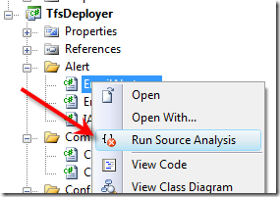
StyleCop
Live Demo

Slide 36
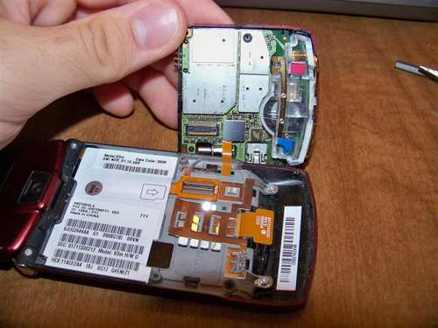

Code Decompilation Tools
dotPeek, ILSpy

Slide 37
Code Decompilation
Code decompilator / code disassembler
Reconstructs the source code (to some extent) from the compiled code
.NET assembly → C# / VB.NET source code
.EXE file → C / C++ / Assembler code
Reconstructed code
Is not always 100% compilable
Loses private identifier names and comments

Slide 38
Code Decomplation Tools
.NET
dotPeek– free, powerful .NET decompiler
ILSpy – powerful, great usability, free
ILDASM – part of .NET SDK, decompiles to IL code
.EXE file
Boomerang Decompiler – outputs C source code
IDA Pro – powerful disassembler / debugger
OllyDbg, W32DASM, etc.

Slide 39


ILSpy
Live Demo

Slide 40



Code Obfuscators
Making Reverse Engineering Difficult

Slide 41
Code Obfuscation
Code obfuscation
Transform the source code or compiled code into a difficult to understand form
Obfuscated code has the same behavior
Sometimes is a bit slower due to changes and additions in the control logic
Obfuscated code is the opposite of the high-quality code
Obfuscation is a form of security through obscurity

Slide 42
Code Obfuscation Techniques
Rewrite for-loops as while-loops followed by a series of cascading if-else statements
Sometimes change iteration into recursion
Obfuscate programming constructs (e.g. turn if-else statements into ?: operators)
Introduce meaningless identifier names
Remove intermediate variables and literals by repeating them as expressions in the code
Remove literals (e.g. 0 and 1) – use expressions
Randomize code formatting

Slide 43
Simple Obfuscation – Example
Original source code in C#
Obfuscated and decompiled
long first = 1
long second = 1;
for (int i = 3; i <= N; i++)
{
result = first + second;
first = second;
second = result;
}
return result;
long _ = 1L;
long __ = 1L;
for (int ___ = 3; ___ <= _____; ___++)
{
____ = _ + __;
_ = __;
__ = ____;
}
return ____;

Slide 44
Obfuscation Tools
.NET obfuscators
dotFuscator
Free, comes with Visual Studio
Eazfuscator.NET
Free trial, commercial license
{smartassembly}
Commercial license, very powerful – assembly obfuscation + compression
Others: Obfuscar (free), SharpObfuscator (free)

Slide 45
EazFuscator.NET
Live Demo

Slide 46

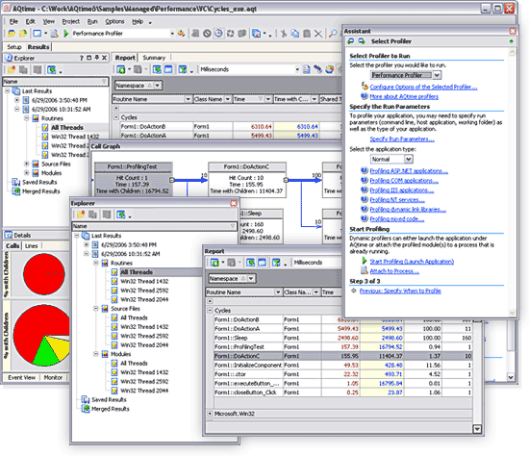
Code Profilers
dotTrace

Slide 47
Profilers
Profilers are tools for gathering performance data and finding performance bottlenecks
Implemented by code instrumentation or based on built-in platform debugging / profiling APIs
Gather statistics for method calls, uses of classes, objects, data, memory, threads, etc.
CPU profilers
Find performance bottlenecks
Memory profilers
Find memory allocation problems

Slide 48

Refactoring Tools
Visual Studio, ReSharper

Slide 49
Refactoring
Refactoring
Improving the design of the existing code without changing its behavior
Typical refactoring patterns
Rename variable / class / method / member
Extract method
Extract constant
Extract interface
Encapsulate field

Slide 50
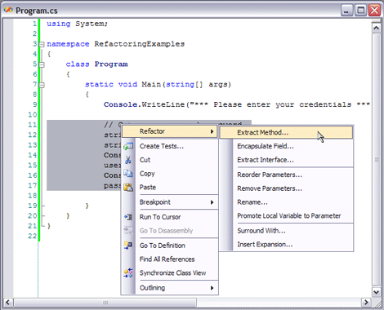
Refactoring in Visual Studio

Slide 51

Refactoring in Visual Studio with / without ReSharper
Live Demo

Slide 52
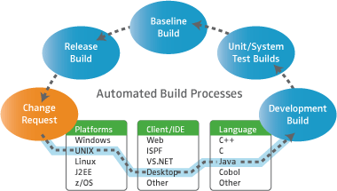
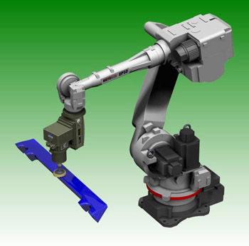
Automated Build Tools
MSBuild

Slide 53
Software Builds
What does it mean to build software?
The process of compiling and assembling the system's modules to obtain the final product
Build activities can also include:
Getting the latest version from the source control repository
Linking external resources
Executing unit tests
Creating installation packages

Slide 54
Sample MS Build File
A .csproj file is actually a MS Build file
<Project xmlns="http://schemas.microsoft.com/developer/msbuild/2003">
<PropertyGroup>
<AssemblyName>MSBuildSample</AssemblyName>
<OutputPath>Bin\</OutputPath>
</PropertyGroup>
<ItemGroup>
<Compile Include="helloworld.cs" />
</ItemGroup>
<Target Name="Build">
<MakeDir Directories="$(OutputPath)" Condition="!Exists('$(OutputPath)')" />
<Csc Sources="@(Compile)" OutputAssembly="$(OutputPath)$(AssemblyName).exe" />
</Target>
</Project>

Slide 55

Documentation Generators
Sandcastle

Slide 56
Documentation Frameworks and Tools
The best source code documentation is the code itself
Special types of comments are used in many platforms
Used to document the code classes, methods, parameters, return types, exceptions, etc.
XML documentation in .NET
Sandcastle Help File Builder
Doxygen-style documentation for C#, C, C++, PHP, Python, Java, etc.

Slide 57

Project Hosting and Team Collaboration Sites
SourceForge, Google Code, CodePlex, Project Locker

Slide 58
Project Hosting Sites
SourceForge – http://www.sourceforge.net
Source control (SVN, Git, …), web hosting, tracker, wiki, blog, mailing lists, file release, statistics, etc.
Free, all projects are public and open source
CodePlex – http://www.codeplex.com
Microsoft's open source projects site
Team Foundation Server (TFS) infrastructure
Source control (TFS), issue tracker, downloads, discussions, wiki, etc.
Free, all projects are public and open source

Slide 59
Project Hosting Sites (2)
Project Locker – http://www.projectlocker.com
Source control (SVN), TRAC, CI system, wiki, etc.
Private projects (not open source)
Free and paid editions
GitHub – https://github.com/
Web-based hosting service for software development projects
Uses the Git revision control system

Slide 60
Project Hosting Sites (3)
Bitbucket – http://bitbucket.org
Source control (Mercurial), issue tracker, wiki, management tools
Private projects, free and paid editions
Others:
Assembla
Unfuddle
XP-Dev
Beanstalk

Slide 61

GitHub
Live Demo

Slide 62

Development Tools
Exercises in Class

Slide 63

Summary
Integrated Development Environments (IDEs)
Source Control Systems and Project Hosting
Logging Tools
Code Analysis Tools and Profilers
Code Obfuscators and Decompilers
Automated Build Tools
Documentation Generators

Slide 64
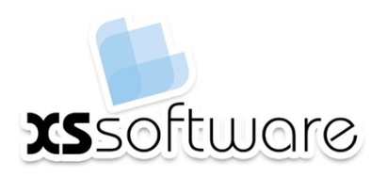








Development Tools
http://softuni.org/courses/high-quality-code

Slide 65

License
This course (slides, examples, demos, videos, homework, etc.) is licensed under the "Creative Commons Attribution-NonCommercial-ShareAlike 4.0 International" license
Attribution: this work may contain portions from
"Fundamentals of Computer Programming with C#" book by Svetlin Nakov & Co. under CC-BY-SA license
"C# Part I" course by Telerik Academy under CC-BY-NC-SA license

Slide 66






Free Trainings @ Software University
Software University Foundation – softuni.org
Software University – High-Quality Education, Profession and Job for Software Developers
softuni.bg
Software University @ Facebook
facebook.com/SoftwareUniversity
Software University @ YouTube
youtube.com/SoftwareUniversity
Software University Forums – forum.softuni.bg

